Slide 1
Basics of Gasification

Slide 2
Acknowledgement
I want to admire that this is not my original work and I had taken various data from different sources. I am very much thankful to all the authors whose data I had used.

Slide 3
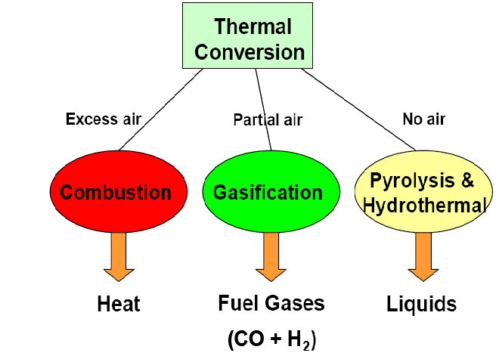
PRIMARY CONSERVATION

Slide 4
WHY GASIFICATION?
Flexible, commercially proven and efficient technology
Reduce overall emissions of SOx, NOx, CO2,particulate matters and chlorine produce
Useful products to maximize profitability
Clean and environmentally-compatible use of high sulfur and heavy metal content fuels
Marginal cost to capture CO2 is low
Flexible design to meet different capacity requirements

Slide 5
WHAT IS GASIFICATION?
  Conversion of any carbonaceous fuel to a gaseous product with a useable heating value
  The feed for Gasification can be
    Gas (e.g., Natural gas)
    Liquid (e.g., Light or Heavy oils)
    Solid (e.g., Petroleum Coke, Coal, Lignite or Biomass)

Slide 6
TYPES OF GASIFIERS
1) Moving/Fixed bed e.g., Lurgi
Counter-current or Up draught/draft
Co-current or Down draught/draft
Cross draught/draft
2) Fluidized bed e.g., Winkler/KBR/U-GAS
Bubbling Fluidized Beds
Circulating Fluidized Beds
3) Entrained flow
Dry pulverized solid fuel e.g., Shell/Prenflo/Siemens
Fuel slurry e.g., GE/Conoco-Philips
Atomized liquid fuel e.g., GE/Shell

Slide 7
APPLICATIONS OF GASIFIER
Used in an internal combustion engine for power generation to substitute fossil fuel
  Diesel engine – for dual fuel application
  Gas engine – for single fuel
Used in heat application
  Low temperature – drying, etc
  High temperature – furnaces, kilns, etc

Slide 8
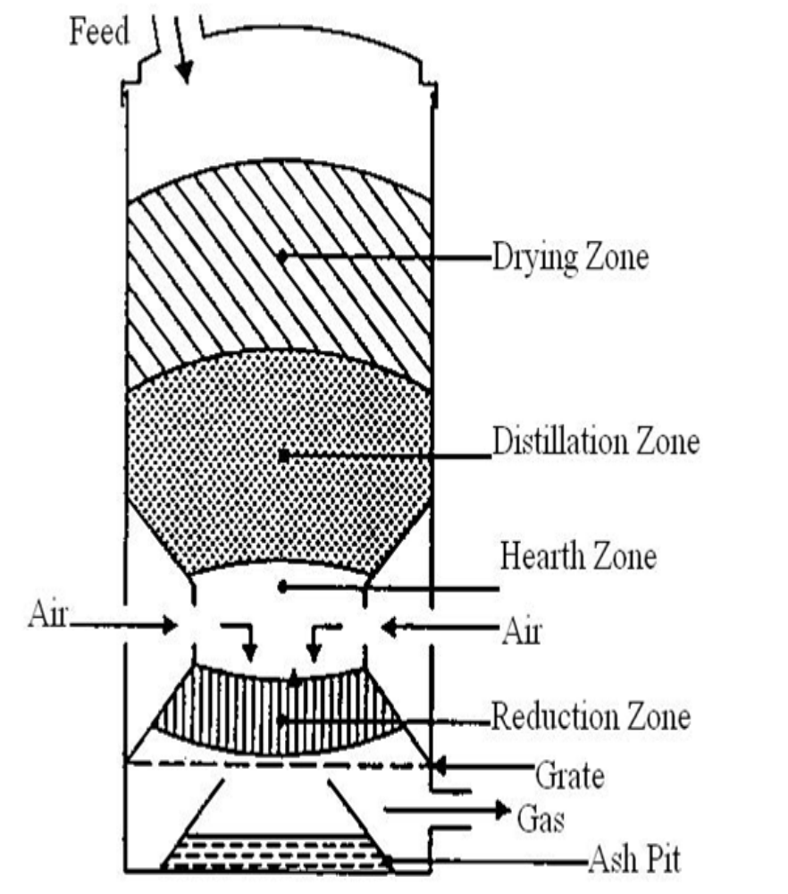
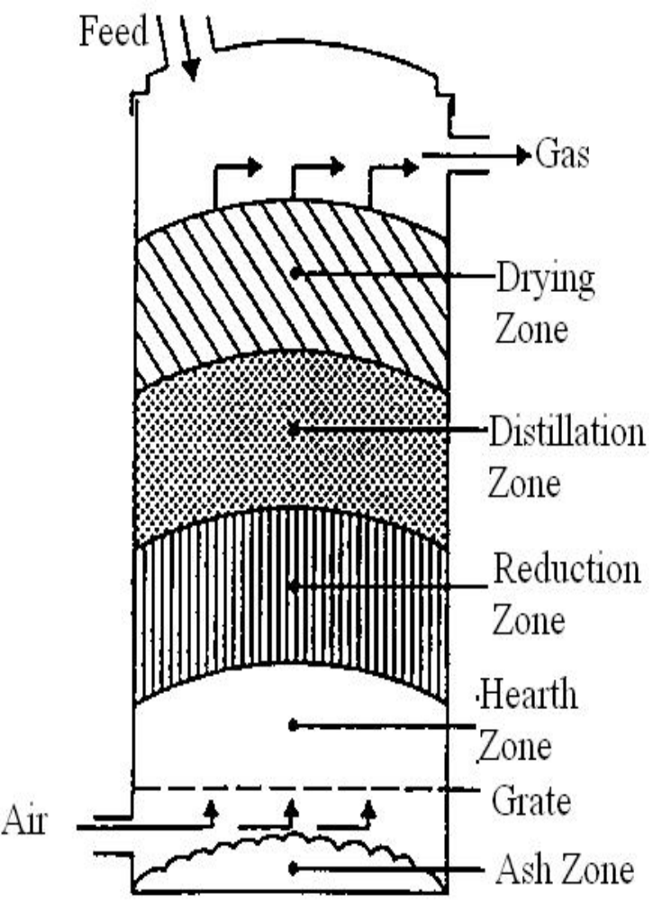
Downdraft Gasifier
Updraft Gasifier

Slide 9
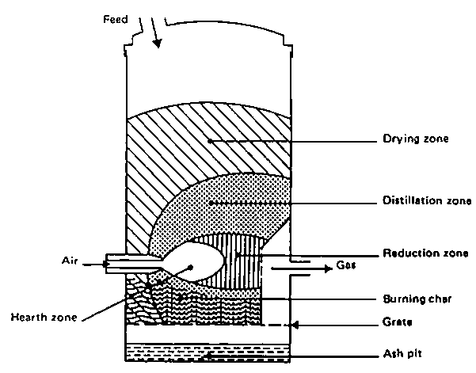
Cross Draft Gasifier

Slide 10
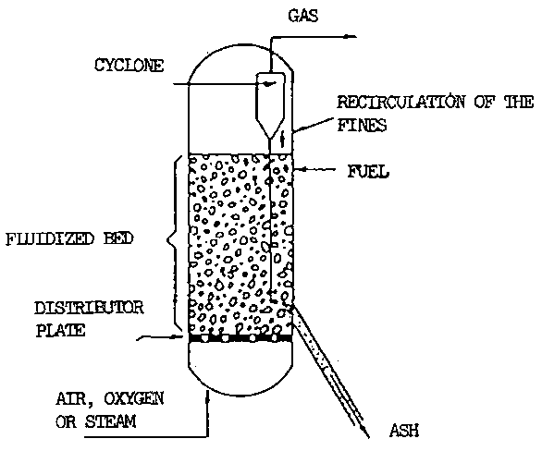
Fluidized Bed Gasifier

Slide 11
The fuel is fed from at the top of the gasifier and the air, (or oxygen, or steam) intake is from the sides, hence the biomass and gases move in the same direction.
Some of the fuel is burnt, falling through the gasifier throat (combustion zone) form a bed of hot charcoal (a reaction zone).
This ensures a fairly high quality syngas, which leaves at the bottom of the gasifier, whereas ash collected in ash pit under the grate.
Suitable for an internal combustion engine

Slide 12
Advantage and Disadvantage of Downdraught Gasifier
Advantage
Flexible adaptation of gas production to load
low sensitivity to charcoal dust and tar content of fuel
Disadvantage
Design tends to be tall
not feasible for very small particle size of fuel

Slide 13
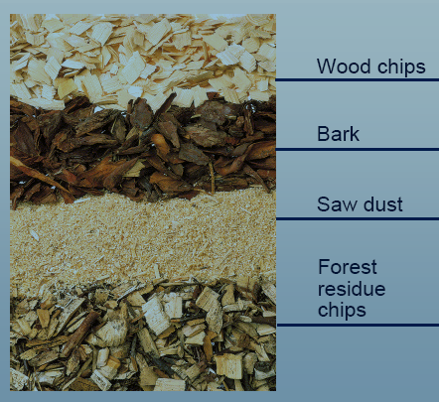
WOOD FUELS FOR GASIFIER

Slide 14
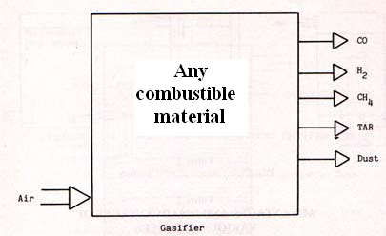
PRODUCT OF GASIFIER

Slide 15
Process Zones
Four distinct processes take place in a gasifier as the fuel makes its way to gasification. They are :
Drying of fuel
Pyrolysis
Combustion
Reduction

Slide 16

GASIFICATION PROCESS IN DOWN DRAGHT GASIFIER

Slide 17
DRYING OF FUEL
All moisture must be removed from fuel for successfully produce gas.
Because of moisture, gas output temperature becomes decrease so gasifier efficiency might be decrease.
In an ideal gasifier, some of heat produced during combustion is used to completely dry the fuel.

Slide 18
PYROLYSIS
A process in which tar and other volatiles are driven off.
It occurs when fuel is heated without enough oxygen to burn. It begins when fuel has reached a minimum temperature around 280˚C.
Up to the temperature of 200˚C only water is driven off.
Between 200 to 280˚C carbon dioxide, acetic acid and water are given off.
The real Pyrolysis, which takes place between 280 to 500˚C, produces large quantities of tar and gases containing carbon dioxide.

Slide 19
COMBUSTION
It is exothermic combination of hydrocarbons with oxygen and yields a theoretical oxidation temperature of 850˚C -1450˚C.
The heat from all the processes is generated from combustion zone.
Producing clean fuel is largely dependent on the combustion dynamics in the gasifier.
C + O2 = CO2
2H2 + O2 = 2H2O

Slide 20
REDUCTION
It reverts complete combustion of hydrocarbon.
It’s endothermic process removal of oxygen from hydrocarbons.
Temperature range normally 800-1000˚C
C + CO2 = 2CO
C + H2O = CO + H2
CO + H2O = CO + H2
C + 2H2 = CH4
CO2 + H2 = CO + H2O

Slide 21
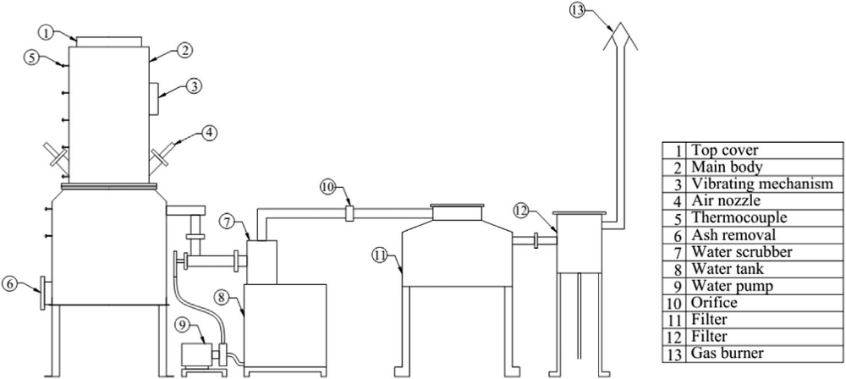
Actual system

Slide 22
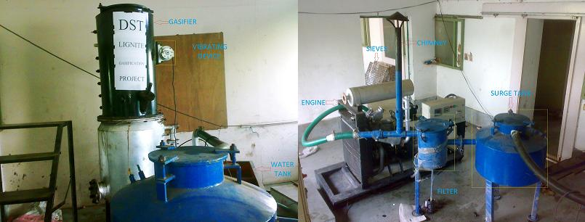
Actual system

Slide 23
Gasifier Cold Gas Efficiency
η = heating value of gas (MJ/Nm³) * Gas flow rate (Nm³/h)
Heating value of biomass (MJ/kg) * Fuel consumption in (kg/h)

Slide 24
THANK YOU

